Slide 1
Platforms to handle Big data
Dr. Jigna Ashish Patel
Assistant Professor, CSE Dept,
Institute of Technology,
Nirma University

Slide 2
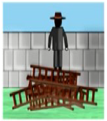
Objective of the lecture
Right platform
Need of the application/algorithm
Right decision

Slide 3
Application/algorithm level requirements
How quickly do we need to get the results?
How big is the data to be processed?
Does the model building require several iterations or single iteration?
Notes:
How quickly do we need to get the results?
Latency Requirements:
Real-Time Processing: If results are needed in real-time or near-real-time (e.g., for live analytics or interactive applications), the algorithm must be highly optimized for speed. This might involve using streaming data processing frameworks like Apache Kafka or Apache Flink.
Batch Processing: If results can be generated in batches (e.g., daily or weekly reports), the system can handle larger volumes of data but may need to optimize for efficient batch processing. Hadoop MapReduce or Apache Spark are typically used for batch processing.
Performance Metrics:
Response Time: Time taken from receiving a request to providing a result.
Throughput: Number of transactions or data points processed per unit of time.
How big is the data to be processed?
Data Size:
Volume: Data size impacts the choice of infrastructure and algorithms. For large-scale data, distributed computing systems like Hadoop or Spark are essential.
Variety: Data can come in various formats (structured, semi-structured, unstructured) and from multiple sources. Ensure that the system can handle diverse data types.
Velocity: The rate at which data is generated and ingested. High-velocity data may require real-time processing capabilities.
Storage and Computing Resources:
Ensure sufficient storage capacity and computational power. Use cloud services or scalable data platforms if needed.
Does the model building require several iterations or a single iteration?
Iterative vs. Single Iteration:
Single Iteration:
Simple Models: Some models might only need a single pass over the data to achieve satisfactory results (e.g., basic linear regression).
Fixed Parameters: When parameters are set once and do not require frequent tuning.
Multiple Iterations:
Complex Models: Machine learning models often require multiple iterations to tune hyperparameters, refine the model, and improve performance (e.g., deep learning models, ensemble methods).
Model Evaluation: Iterative training, validation, and testing are necessary to evaluate model performance and avoid overfitting or underfitting.
Optimization: Techniques like grid search or random search for hyperparameter tuning may involve multiple iterations.

Slide 4
System/platform level requirements
Will there be a need for more data processing capability in the future?
Is the rate of data transfer critical for this application?
Is there a need for handling hardware failures within the application?
Notes:
1. Future Data Processing Capability
Scalability:
Horizontal Scaling: Ensure the system can scale out by adding more nodes to handle increasing data volumes. Distributed systems like Hadoop and Spark support horizontal scaling.
Cloud Services: Cloud platforms like AWS, Azure, or Google Cloud offer elastic scalability, allowing you to adjust resources based on demand.
Performance Monitoring:
Implement performance monitoring and capacity planning to anticipate future needs. Tools like Prometheus, Grafana, or cloud-native monitoring services can help track resource usage and predict when additional capacity will be needed.
Modular Architecture:
Design the system with modular components that can be upgraded or replaced independently. This flexibility allows you to enhance processing capabilities as needed.
2. Rate of Data Transfer
Throughput Requirements:
High Throughput: If your application requires high data transfer rates (e.g., for real-time analytics), ensure the system supports high-speed data ingestion and processing. Technologies like Apache Kafka or Apache Flink can handle high-throughput data streams.
Network Bandwidth:
Ensure sufficient network bandwidth to handle data transfer between nodes, especially for distributed systems. Network bottlenecks can impact performance.
Data Transfer Optimization:
Use data compression and efficient serialization formats (e.g., Parquet, Avro) to reduce the amount of data transferred and improve transfer speeds.
3. Handling Hardware Failures
Fault Tolerance:
Data Replication: Implement data replication strategies to ensure data durability. For instance, Hadoop's HDFS replicates data across multiple nodes to handle hardware failures.
Redundancy: Use redundant components and failover mechanisms to ensure continuous operation in case of hardware failures.
Error Detection and Recovery:
Implement monitoring and alerting systems to detect hardware failures and system issues. Automated recovery processes can help mitigate the impact of failures.
Backup and Recovery:
Regularly back up data and configuration settings. Implement disaster recovery plans to restore services in case of catastrophic failures.

Slide 5
Scaling
Scaling is the ability of the system to adapt to increased demands in terms of data processing

Slide 6
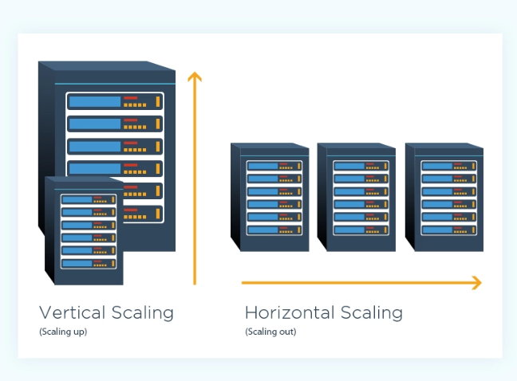

Slide 7
Horizontal Scaling
It involves distributing the workload across many servers which may be even commodity machines.
It is also known as “scale out”, where multiple independent machines are added together in order to improve the processing capability.
Typically, multiple instances of the operating system are running on separate machines.

Slide 8
Vertical Scaling
Vertical Scaling involves installing more processors, more memory and faster hardware, typically, within a single server.
It is also known as “scale up” and it usually involves a single instance of an operating system.

Slide 9
Comparison of Pros and cons
Horizontal Scaling
Incremental performance upgrades
Lower financial entry for each upgrade
Unlimited scaling potential
More complexity in data distribution and management
Limited availability of supporting software

Slide 10
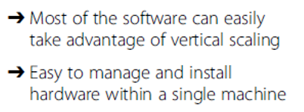
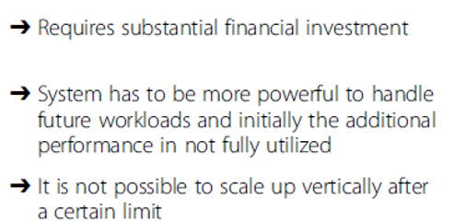
Comparison of Pros and cons
Vertical Scaling

Slide 11
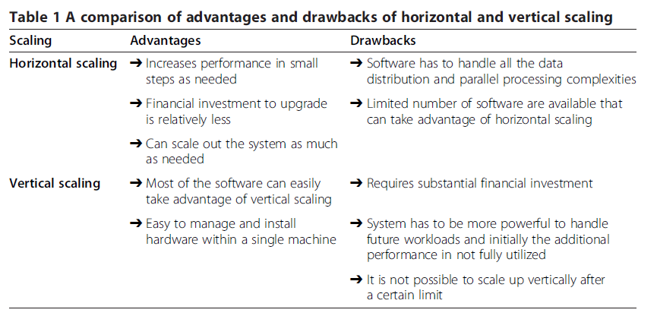

Slide 12
Horizontal Scaling Platforms
Peer-to-Peer Network
Apache Hadoop
Apache Spark
Vertical Scaling Platforms
High performance computing clusters
Multicore CPU
Graphics Processing Unit(GPU)
Field Programmable gate arrays(FPGA)

Slide 13
Peer-to-Peer networks
involve millions of machines connected in a network
decentralized and distributed network architecture where the nodes in the networks (known as peers) serve as well as consume resources.
oldest distributed computing platforms
Message Passing Interface (MPI) for communication scheme used in such a setup to communicate and exchange the data between peers.
Each node can store the data instances and the scale out is practically unlimited (can be millions of nodes).

Slide 14
Apache Hadoop
open source framework for storing and processing large datasets using clusters of commodity hardware.
Hadoop is designed to scale up to hundreds
highly fault tolerant
The Hadoop platform contains the following two important components: (1) HDFS (2) YARN

Slide 15
Apache Spark
developed by researchers at the University of California at Berkeley. designed to overcome the disk I/O limitations
ability to perform in-memory computations.
allows the data to be cached in memory, thus eliminating the Hadoop’s disk overhead limitation for iterative tasks.
supports Java, Scala and Python and for certain tasks
it is tested to be up to 100× faster than Hadoop MapReduce

Slide 16
HPC clusters
Known as blades or supercomputers, are machines with thousands of cores.
They can have a different variety of disk organization, cache, communication mechanism etc.
powerful hardware which is optimized for speed and throughput.
They are not as scalable as Hadoop or Spark clusters but they are still capable of processing terabytes of data.

Slide 17
Multicore CPU
Multicore refers to one machine having dozens of processing cores They usually have shared memory but only one disk.
the number of cores per chip and the number of operations that a core can perform has increased significantly. Newer breeds of motherboards allow multiple CPUs within a single machine thereby increasing the parallelism.
Until the last few years, CPUs were mainly responsible for accelerating the algorithms for big data analytics.

Slide 18
GPU
It is designed to accelerate the creation of images in a frame buffer intended for display output
GPUs were primarily used for graphical operations such as video and image editing, accelerating graphics-related processing etc. due to their massively parallel architecture, recent developments in GPU hardware and related programming frameworks have given rise to GPGPU
In addition to the processing cores, GPU has its own high throughput DDR5 memory which is many times faster than a typical DDR3 memory.

Slide 19
FPGA
highly specialized hardware units for specific applications
FPGAs can be highly optimized for speed and can be orders of magnitude faster compared to other platforms for certain applications.
Due to customized hardware, the development cost is typically much higher compared to other platforms.
On the software side, coding has to be done in HDL with a low-level knowledge of the hardware which increases the algorithm development cost.

Slide 20
Comparison of platforms
System/Platform Level characteristics
Scalability
Data I/O performance
Fault Tolerance

Slide 21
Scalability
Platform | Scalability
Peer-to-Peer | * * * * *
Virtual Clusters(MapReduce/MPI) | * * * * *
Virtual Clusters(Spark) | * * * * *
HPC clusters (MPI/MapReduce) | * * *
Multicore(Multithreading) | * *
GPU(CUDA) | * *
FPGA(HDL) | *

Slide 22
Scalability
★★★★★ Peer-to-Peer / Virtual Clusters – Horizontal scaling on commodity hardware.
★★★ HPC – Limited by interconnect and infrastructure cost.
★★ Multicore / GPU – Limited to hardware in a single machine.
★ FPGA – Hardware fixed, costly scaling.

Slide 23
Data I/O Performance
Platform | Data I/O performance
Peer-to-Peer | *
Virtual Clusters(MapReduce/MPI) | * *
Virtual Clusters(Spark) | * * *
HPC clusters (MPI/MapReduce) | * * * *
Multicore(Multithreading) | * * * *
GPU(CUDA) | * * * * *
FPGA(HDL) | * * * * *

Slide 24
Data I/O Performance
GPU / FPGA (★★★★★) – High-bandwidth memory (HBM), parallel processing.
Multicore (★★★★) – Shared memory, no network latency.
Spark (★★★) – In-memory RDD, better than MapReduce.
MapReduce (★★) – High disk I/O overhead.
Peer-to-Peer (★) – Slow, no optimized I/O.

Slide 25
Fault Tolerance
Platform | Fault Tolerance
Peer-to-Peer | *
Virtual Clusters(MapReduce/MPI) | * * * * *
Virtual Clusters(Spark) | * * * * *
HPC clusters (MPI/MapReduce) | * * * *
Multicore(Multithreading) | * * * *
GPU(CUDA) | * * * *
FPGA(HDL) | * * * *

Slide 26
Reasoning for Fault Tolerance
★★★★★ Virtual Clusters (Hadoop/Spark)
Data replication (HDFS), recomputation on failure.
★★★★ HPC / Multicore
HPC uses checkpointing; multicore has OS-level fault handling.
★★★ GPU / FPGA
No native fault tolerance; requires external framework or hardware redundancy.
★ Peer-to-Peer
No built-in mechanism, dependent on peers.

Slide 27
Comparison of platforms
Application/Algorithm Level characteristics
Real time processing
Data size supported
Iterative task support

Slide 28
Real Time Processing
Platform | Real Time Processing
Peer-to-Peer | *
Virtual Clusters(MapReduce/MPI) | * *
Virtual Clusters(Spark) | * *
HPC clusters (MPI/MapReduce) | * * *
Multicore(Multithreading) | * * *
GPU(CUDA) | * * * * *
FPGA(HDL) | * * * * *

Slide 29
Real Time Processing
FPGA & GPU (★★★★★ – Excellent):
Custom hardware pipelines (FPGA) and massive parallelism (GPU) allow microsecond-level latency.
Multicore (★★★★):
Good for real-time tasks on shared memory within a single system.
HPC (★★★):
Low-latency interconnect, but heavy jobs make true real-time hard.
Spark / MapReduce (★★):
Spark can be near real-time (micro-batching), but not true real-time.
Hadoop MapReduce is batch-oriented → poor real-time.
Peer-to-Peer (★):
High latency, not suitable for real-time.

Slide 30
Data Size supported
Platform | Data Size supported
Peer-to-Peer | * * * * *
Virtual Clusters(MapReduce/MPI) | * * * *
Virtual Clusters(Spark) | * * * *
HPC clusters (MPI/MapReduce) | * * * *
Multicore(Multithreading) | * *
GPU(CUDA) | * *
FPGA(HDL) | * *

Slide 31
Data Size Supported
Peer-to-Peer (★★★★★):
Extremely scalable for file distribution (e.g., torrents).
HPC & Virtual Clusters (★★★★):
Handles very large datasets, but depends on infrastructure cost.
Spark & MapReduce (★★★★):
Built for massive datasets on commodity hardware.
GPU / FPGA (★★):
Memory limits restrict size (typically GBs, not TBs).
Multicore (★★):
Limited to system memory (tens or hundreds of GBs).

Slide 32
Iterative Task Support
Platform | Iterative task support
Peer-to-Peer | * *
Virtual Clusters(MapReduce/MPI) | * *
Virtual Clusters(Spark) | * * *
HPC clusters (MPI/MapReduce) | * * * *
Multicore(Multithreading) | * * * *
GPU(CUDA) | * * * *
FPGA(HDL) | * * * *

Slide 33
Iterative Task Support
HPC, GPU, FPGA, Multicore (★★★★):
Excellent for iterative scientific simulations or deep learning training loops.
Spark (★★★):
Designed for iterative ML tasks (via RDDs and DAG execution).
MapReduce (★★):
Poor because it writes intermediate data to disk after every stage.
Peer-to-Peer (★★):
Minimal support; not designed for iterative computation.

Slide 34
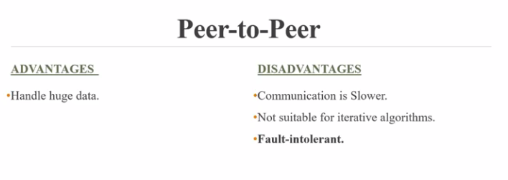
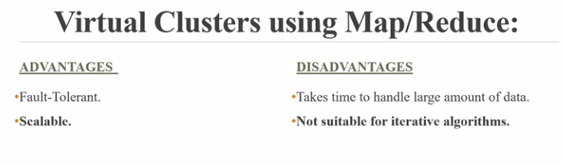

Slide 35
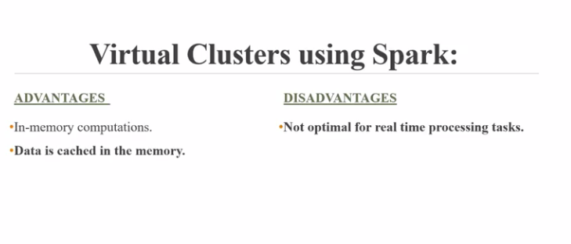
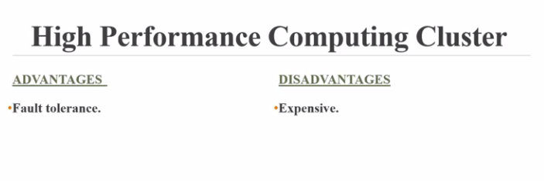

Slide 36
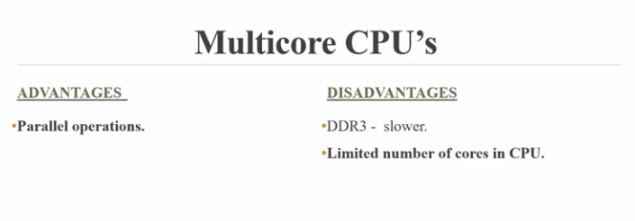
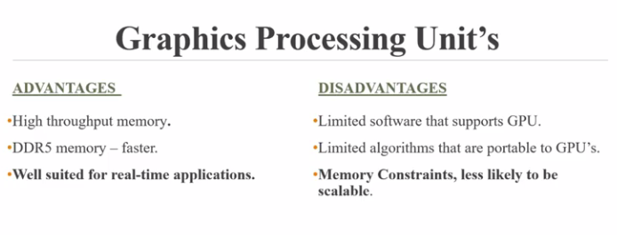

Slide 37
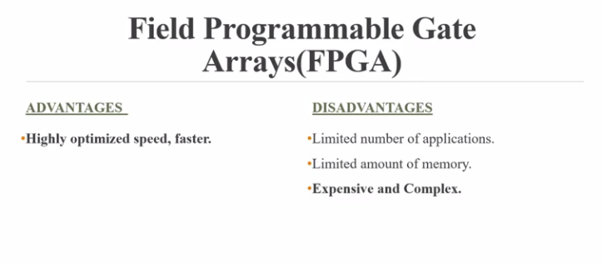

Slide 38
How will you choose one of platform for a particular criteria ?

Slide 39
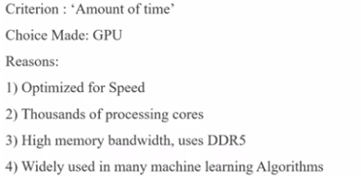
Amount of Time

Slide 40
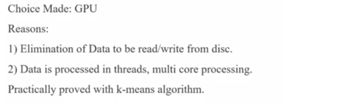
Number of Iterations

Slide 41
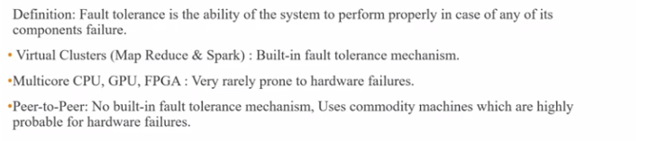
Fault Tolerance

Slide 42
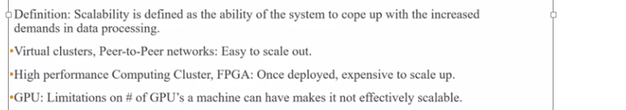
Scalability

Slide 43
Choice of platform
Data size
Speed/Throughput
Training /Applying a model

Slide 44
K means clustering

Slide 45
K-means on MapReduce

Slide 46
K-means on MPI

Slide 47
K-means on GPU

